Slide 1

AUTOMATIC RAILWAY GATE CONTROL SYSTEM
Team Members
1) V.Ujwala
2) M.Snehitha
3) V.Vineeth
4) S.Saneeth
5) R.Arun

Slide 2
NEED STATEMENT
No man railway gates lead to major human casualties. There is a need for automated railway gates.

Slide 3
CONTENTS
ABSTRACT
INTRODUCTON
OBJECTIVE
BENCHMARKS
EXISTING SOLUTIONS
PROPOSED DESIGN
COMPONENTS REQUIRED WITH SPECIFICATIONS
CIRCUIT DIAGRAM
BLOCK DIAGRAM
FUNCTIONS
CONSTRAINTS
CONCLUSION
REFERENCES

Slide 4
ABSTRACT
The crossing of railway gates is a tedious job for normal people. They have to wait for a long time even before and after arrival and departure of the trains. In rapidly flourishing country like India, accidents in the unmanned level crossings are increasing day by day. At present, in level crossings the railway gate is operated normally by a gate keeper after receiving the information about the train’s arrival. Instead of waiting such a long time at the railway gates and to avoid accidents in level crossings a project is proposed that controls the gate automatically with out involvement of the railway level crossing gate keeper. It can also implemented in unmanned level crossings at remote areas.
The train arrival and departure would sensed by 2 sensors. When ever the first sensor senses the train is near by means it sends a signal to preprogrammed micro controller which the railway gate is controlled by means of a dc motor. Then the gate closes and opens when the second sensor senses the train departure. The Automatic Railway Gate Control Abstract deals in detail the circuit description along with the component description, required Software and Coding.

Slide 5
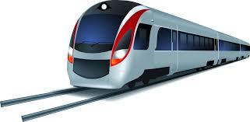
INTRODUCTION
According to the statistics from 2009-2015, there were about 800 railway accidents and more than 30% of these accidents were due to unman level crossing. About 1800 people were injured and more than 500 were dead. In most cases the crashes occurred when the driver does not pay attention to the warning devices. The main problem around railway crossing is that the motorists drive around the crossing the gates while they are down. So, more efforts are required for railway crossing safety. In India over thousands of trains are running on tracks everyday .There are many unmanned railway crossings on the tracks which are susceptible to accidents. To avoid accidents at railway crossings, automatic and independent railway gate system comes in picture. Using simple electronic components, we have successfully tried to automate the control of railway gates.

Slide 6
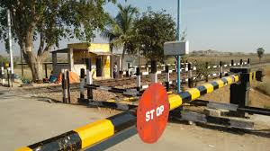
OBJECTIVE
Following are the objectives to be established on full fledged operation of our prototype on a large scale basis:
Removal of human intervention at level crossings.
Ensuring the safety of passengers.
Avoiding delay in the closing of manual level crossing barriers though train is at the nearest distance and is approaching fast.

Slide 7
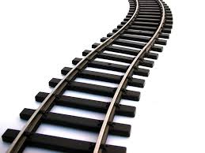
BENCHMARKS
There was only single red-light crossing.
A second light was introduced to the red-light crossing.
Bells were introduced to the existed system.
Sign boards were introduced.
Further, half-barriers and LED lights were introduced.
Full-barriers for pedestrians with active warning systems.
Remote operating of full-barriers from traffic control cameras.
Along with them, two alternative flashlights accompany the barriers, which can be manual or automatic.
Automatic level crossing sensors for obstacle detection.

Slide 8
EXISTING SOLUTIONS
Level crossing in the form of lifting barriers.
Lifting barriers which, at one end, are to be placed with a heavy load for closing the barrier. For opening the barrier, we just have to remove the heavy load.
Lifting barriers which can be opened and closed by the operation of a switch manually.
Lifting barriers (operated by switch) accompanied by sound buzzers for warning the passengers.
Lifting barriers which are to be directly operated by a man, i.e. one will lift the barrier up and pull it down, which is clamped at one end.
Lifting barriers which are clamped at one end and the other end is tied with a rope. Untying the rope would open the barrier.
Movable gates of approved design are also used at some places.

Slide 9

PROPOSED DESIGN
In designing our prototype we have used a set of components which we would be knowing about further. The working of the prototype is explained as follows:
The arrival of the train is detected by the IR sensors placed on either side of the gate, at required distance from the level crossing.
Once arrival is sensed, the signal is sent to the microcontroller or the Arduino board.
Subsequently, in response to this, the gates are closed.
The departure of the train is detected by the IR sensors placed at required distance from the gates.
The signal about departure is sent to the Arduino board , which in turn operates the motor and opens the gates.

Slide 10
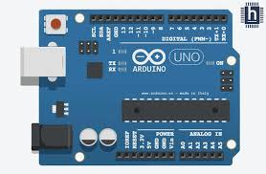
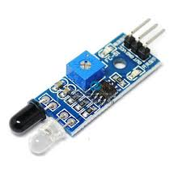
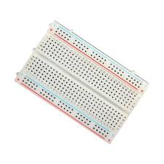
COMPONENTS REQUIRED WITH SPECIFICATIONS
Arduino UNO board
IR sensors
Bread board
Toy train
Connecting wires
Servo motor

Slide 11
Arduino UNO board
The Arduino Uno is a microcontroller board based on the ATmega328 (datasheet). It has 14 digital input/output pins (of which 6 can be used as PWM outputs), 6 analog inputs, a 16 MHz ceramic resonator, a USB connection, a power jack, an ICSP header, and a reset button. It contains everything needed to support the microcontroller; simply connect it to a computer with a USB cable or power it with a AC-to-DC adapter or battery to get started.
Technical specifications are as follows:
Operating Voltage: 5 Volt
Input Voltage: 7 to 20 Volts
Digital I/O Pins: 14 (of which 6 provide PWM output)
Analog Input Pins: 6
DC Current per I/O Pin: 20 mA
DC Current for 3.3V Pin: 50 mA
Flash Memory: 32 KB of which 0.5 KB used by bootloader
SRAM: 2 KB
EEPROM: 1 KB
Clock Speed: 16 MHz
Length: 68.6 mm
Width: 53.4 mm
Weight: 25 g

Slide 12
IR Sensors
An infrared sensor is an electronic instrument that is used to sense certain characteristics of its surroundings. It does this by either emitting or detecting infrared radiation. The module features a 3 wire interface with Vcc, GND and an OUTPUT pin on its tail. It works fine with 3.3 to 5V levels. Upon hindrance/reflectance, the output pin gives out a digital signal (a low-level signal). The onboard preset helps to fine tune the range of operation, effective distance range is 2cm to 80cm

Slide 13
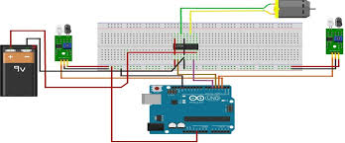
CIRCUIT DIAGRAM

Slide 14
FUNCTIONS
Ensuring the safety of the passengers.
Trying to reduce the number of accidents taking place at level crossings across the country.
Increasing the scope of detecting the obstacles present on the railway track.

Slide 15
CONSTRAINTS
Controlling the speed of the vehicles at a certain distance before the level crossing.
Installation of appropriate warning signals at the required distance at level crossings and making sure that the warning signs are properly communicated to the passengers.

Slide 16

CONCLUSION
It is a challenge to save the human life and vehicles from miserable train accidents in the era of modern science and technology. It is tried to automate various operations related to opening and closing of railway gates in this prototype. Thus accidents are avoided at places where there is no person managing the railway crossing gates. This system reduces the waiting time of road passengers at the railway crossings since it will identify the arrival of the train and there by closing the gate when needed. The present system is a proto type model which can be expanded to be operational in actual real time systems.

Slide 17
REFERENCES
https://www.slideshare.net/mohamedmagdy927/automatic-railway-gate-control-22765999
https://ece-eee.final-year-projects.in/a/145-microcontroller-based-automatic-railway-gate-control.html
https://pdfs.semanticscholar.org/d14a/c79d94db56bb539146a5771b8175060ac76e.pdf
http://1000projects.org/automatic-railway-gate-control.html
http://www.rdso.indianrailways.gov.in/works/uploads/File/Handbook%20on%20Level%20Crossing(1).pdf
http://www.circuitstoday.com/automatic-railway-gate-control-using-arduino-ir-sensor
http://files.aust-eee-2211-project.webnode.com/200000167-a7a29a997a/Automatic%20Railway%20Gate.pdf

